Slide 1
DSCI 633 Final Project
Predicting Readmission in 30 days

Slide 2
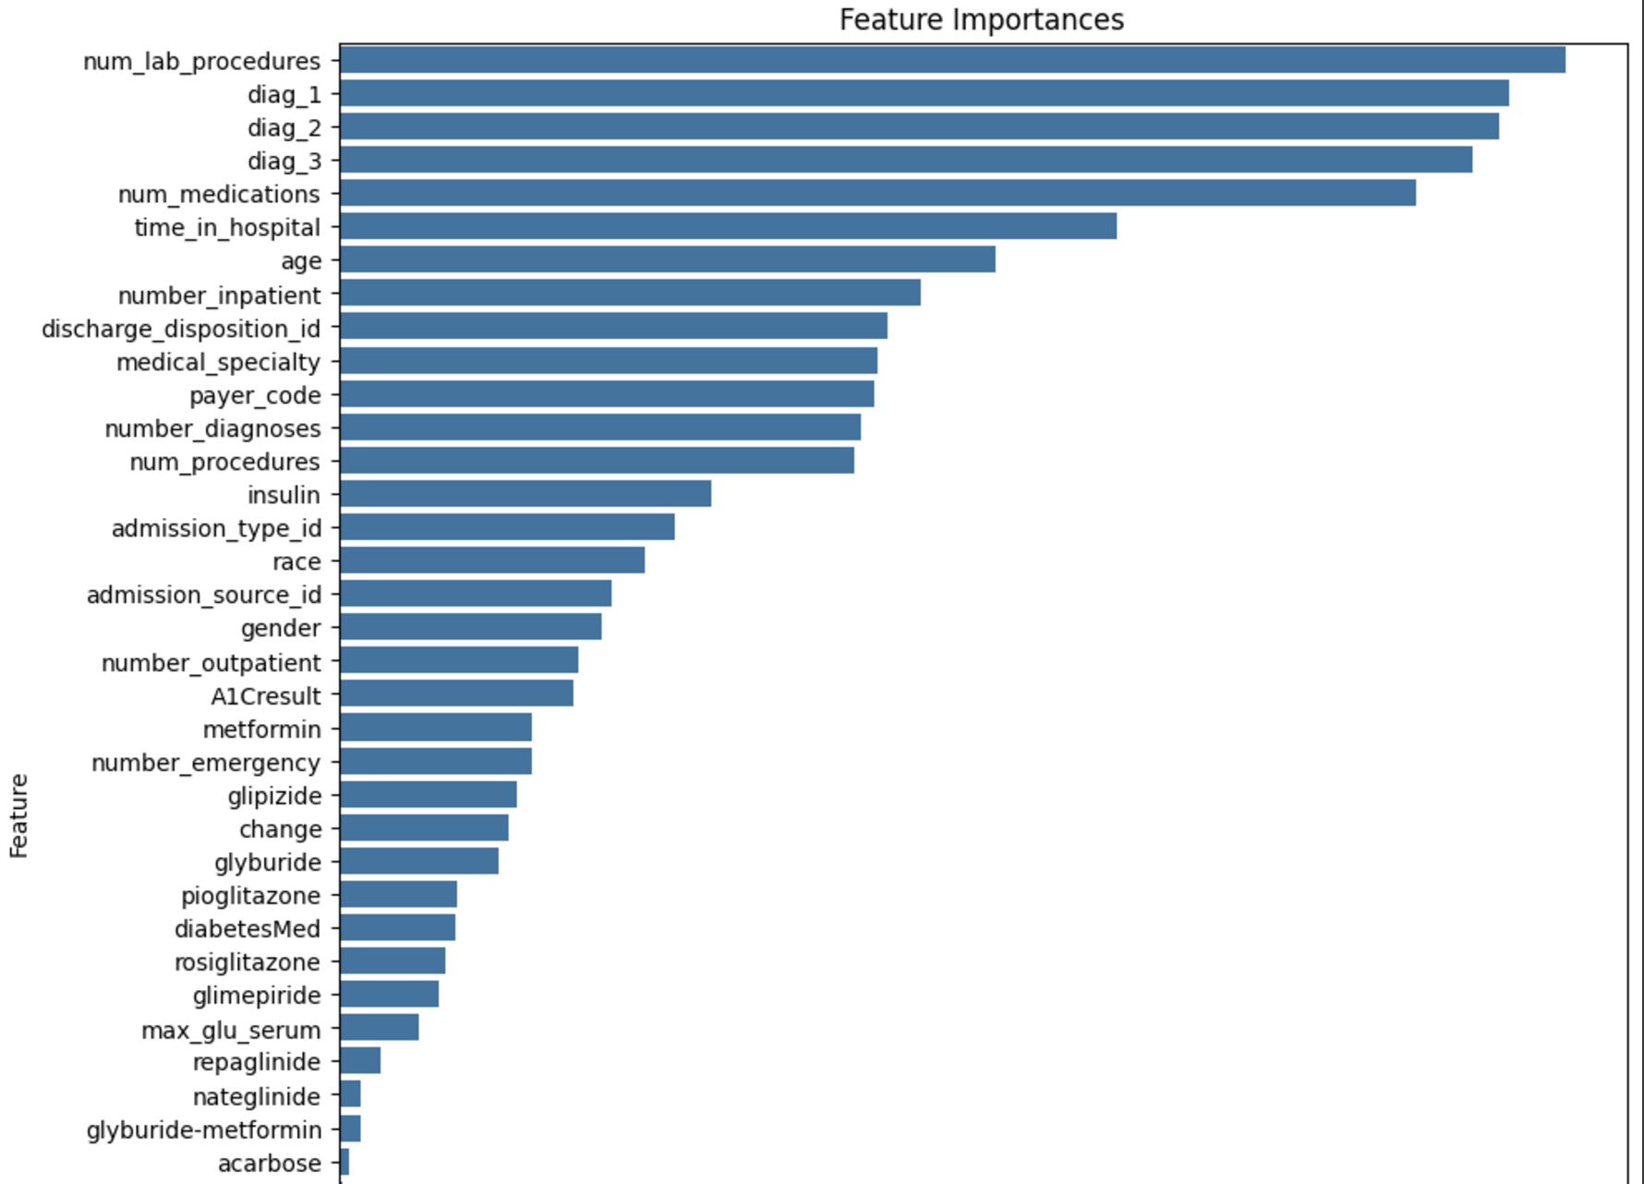
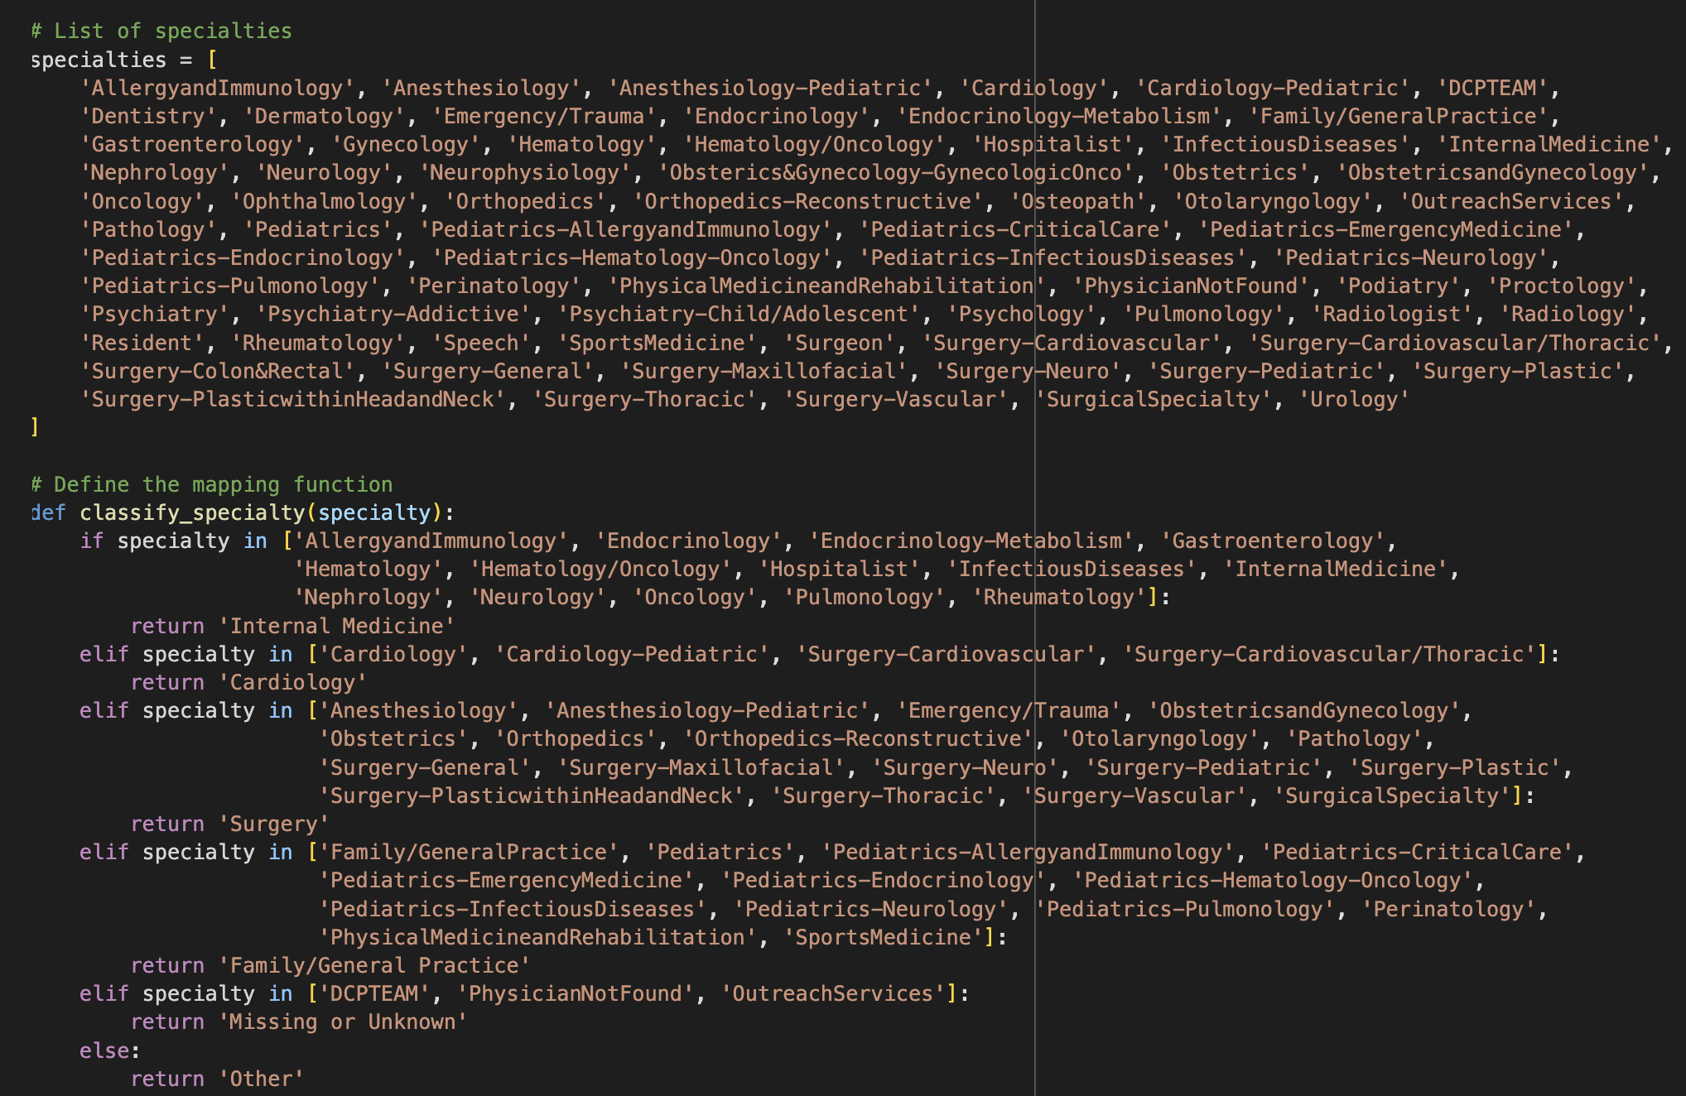
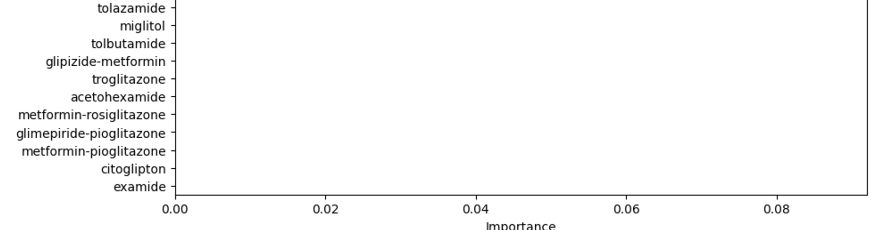
Approach
Initial look at the dataset -> removing low-data columns (weight, payer-code)
Label Encoding vs. One-Hot Encoding?
What features to use? (See graph of RF)
Reducing diagnosis into categories:

Slide 3
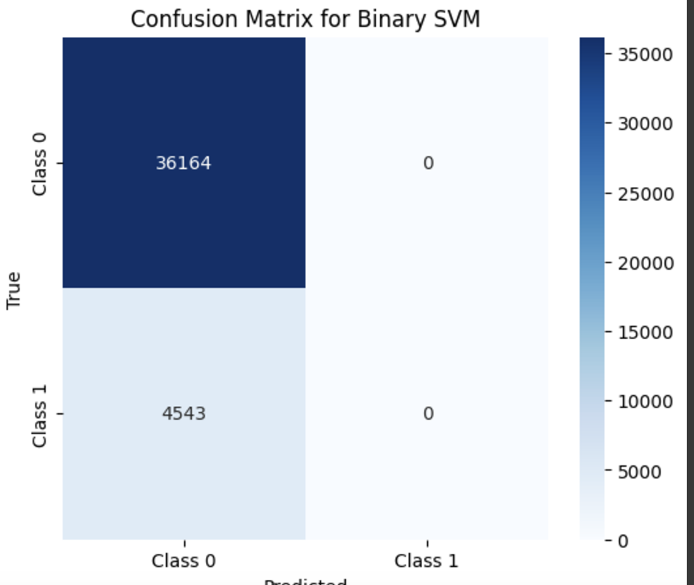
Challenges + Failures
Accuracy is not a good measure of model
Time constraints and processing power
Using the right SMOTE, <30 was vastly under-represented
When to Scale, SMOTE, and PCA

Slide 4
Models Used vs. Final Models
Logistic Regression
Random Forest Classifier
Gaussian Naive Bayes
Support Vector Machines
GridSearchCV
Decision Tree
XGBoost
AdaBoost
Gaussian Naive Bayes
Decision Tree
AdaBoost
Random Forest Classifier
GridSearchCV

Slide 5
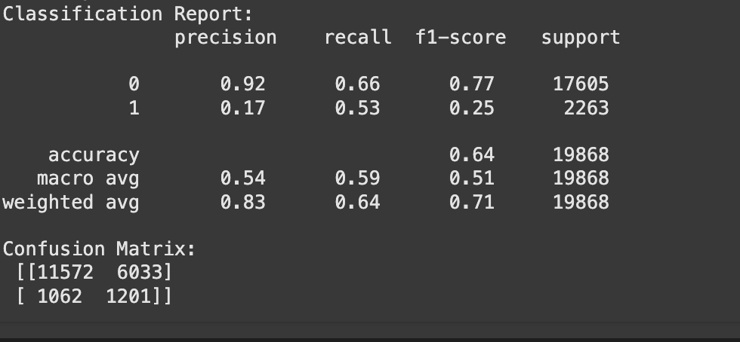
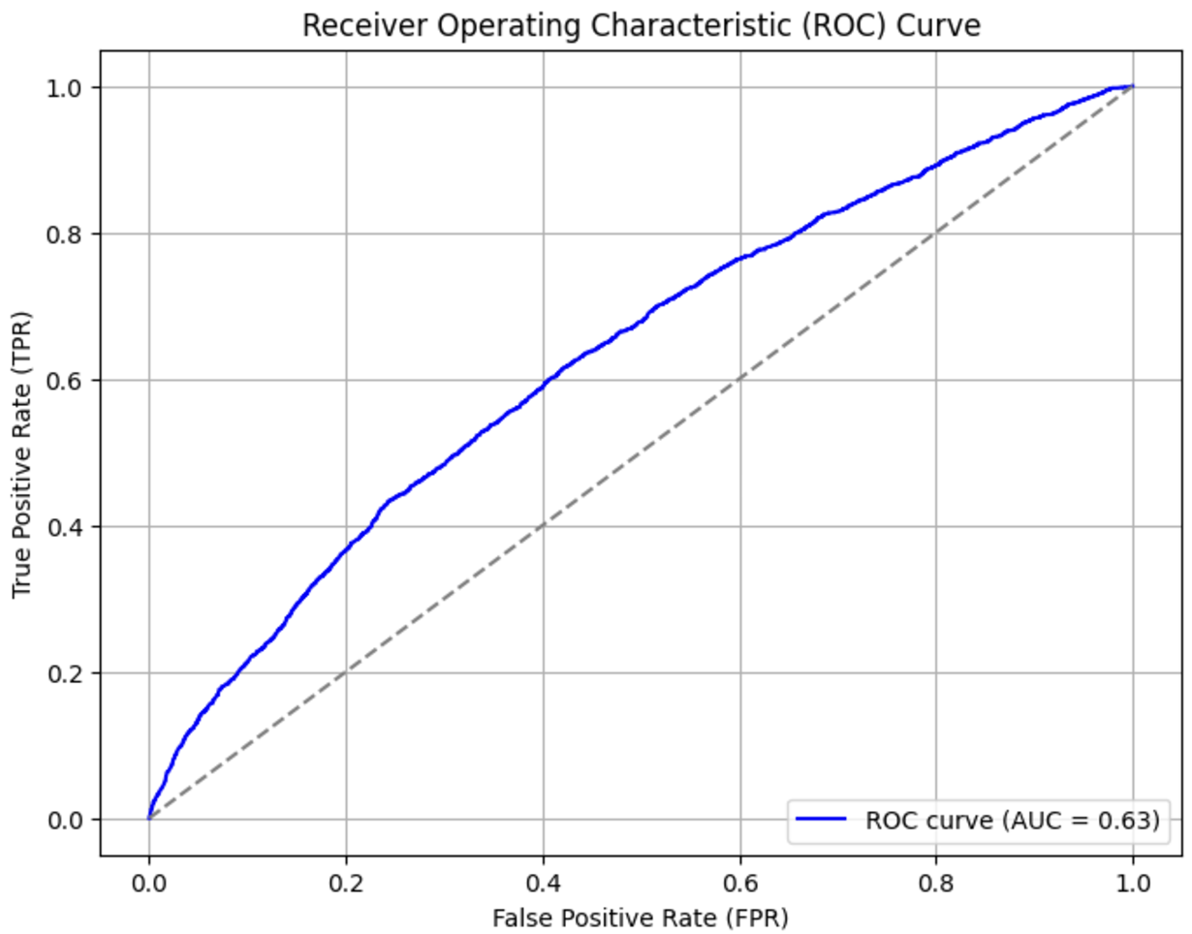
Model -> AdaBoost
Predicted the most <30 correctly
Best AUC of 0.63

Slide 6
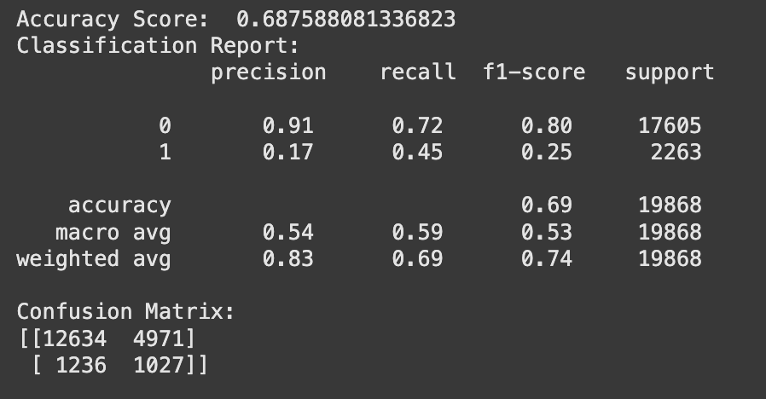
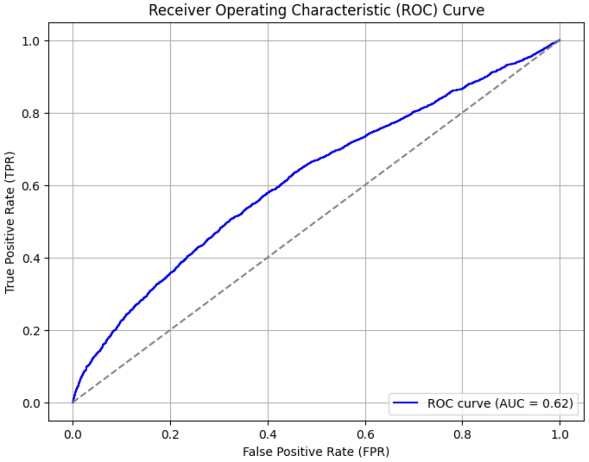
Model -> Gaussian NB
Same f1-score
AUC of 0.62
Lower Recall

Slide 7
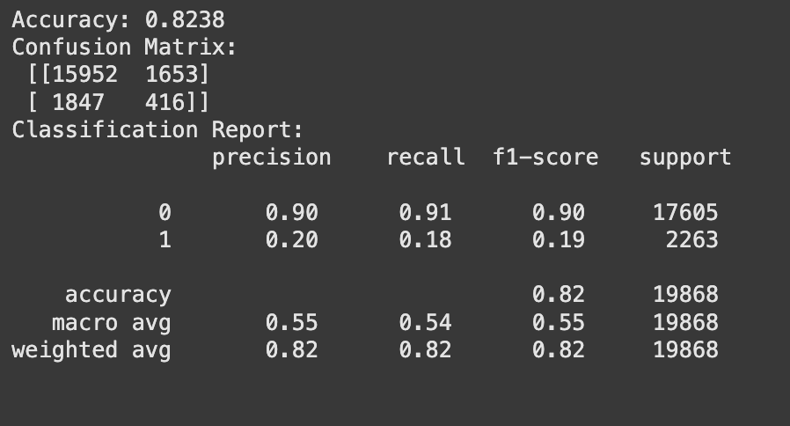
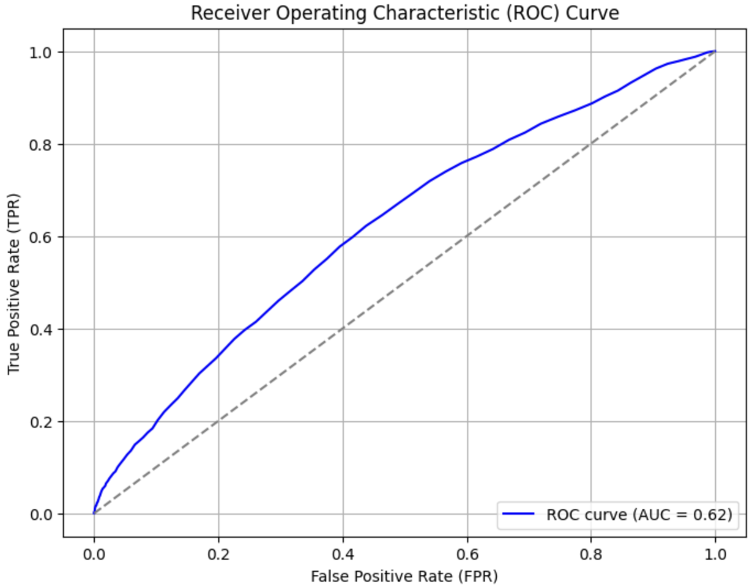
Model -> Random Forest
“Accurate”
AUC of 0.62
Best Precision of <30

